Slide 1
Decision Forests
About Authors

Slide 2

What is Decision tree?

Slide 3
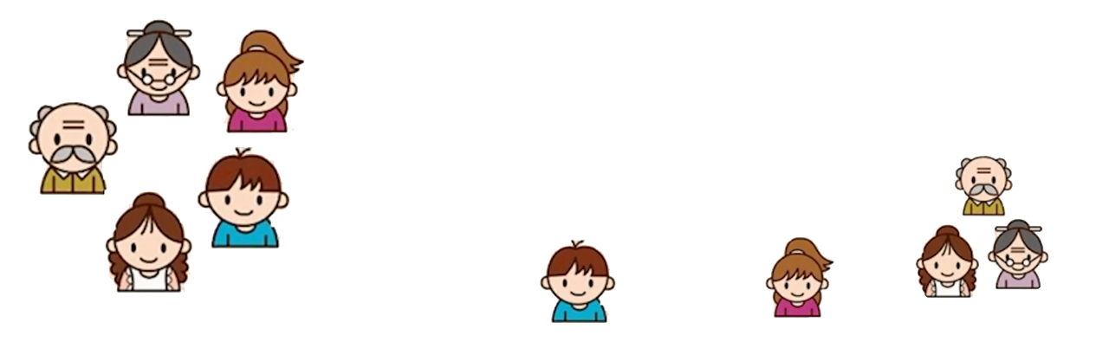
Decision Tree
Input: age, gender, occupation etc
Does the person like computer games?
Age < 15
Yes
No
Is male?
Yes
No
Prediction score in each leaf
+2
+0.1
-1

Slide 4
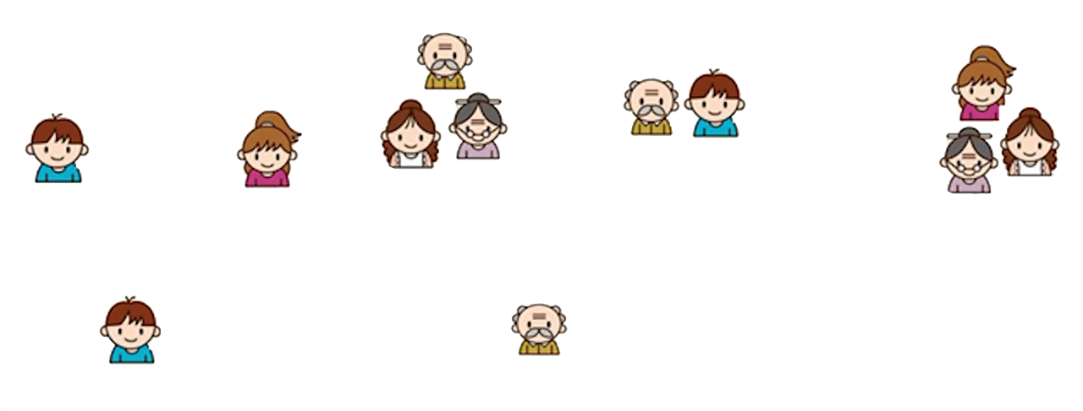
Tree 1
Tree 2
Age < 15
Use computer daily?
Yes
No
Yes
No
Is male?
Yes
No
+2
+0.1
-1
+0.9
-0.9
f ( )=2+0.9=2.9
f ( )=-1+0.9=-0.1

Slide 5
Decision Trees pros and cons
Advantages:
Easy to interpret
Applicable for continuous and categorical input
Implicitly perform feature selection
Require relatively little effort from users for data preparation
Disadvantages:
Exponential calculation growth with data getting bigger
The high classification error rate for small training set
High variance

Slide 6
Can it be done better?

Slide 7
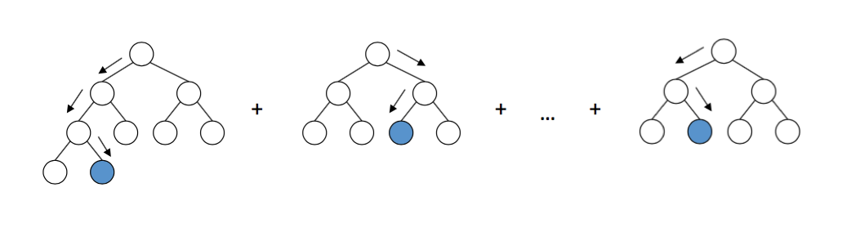
Gradient boosting
Ensemble of weak learners to get strong result.

Slide 8
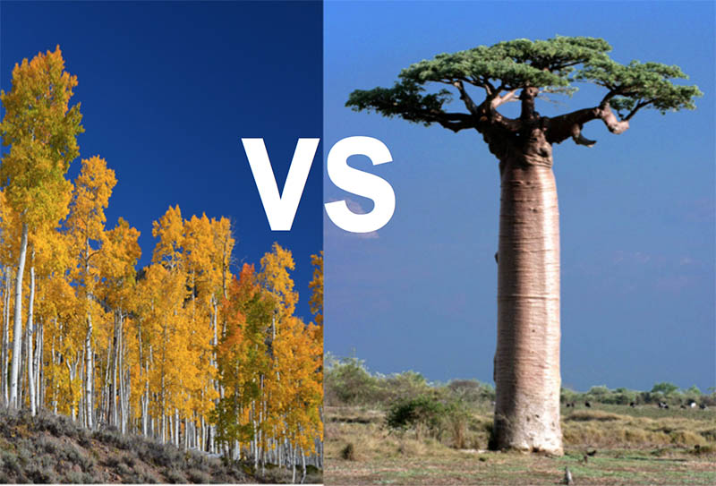
Gradient boosting components
Shallow decision trees with few nodes
High bias & low variance
“Decision stumps”: tree with one split

Slide 9
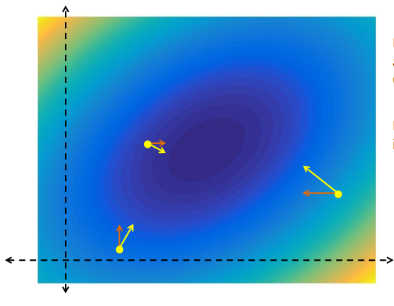
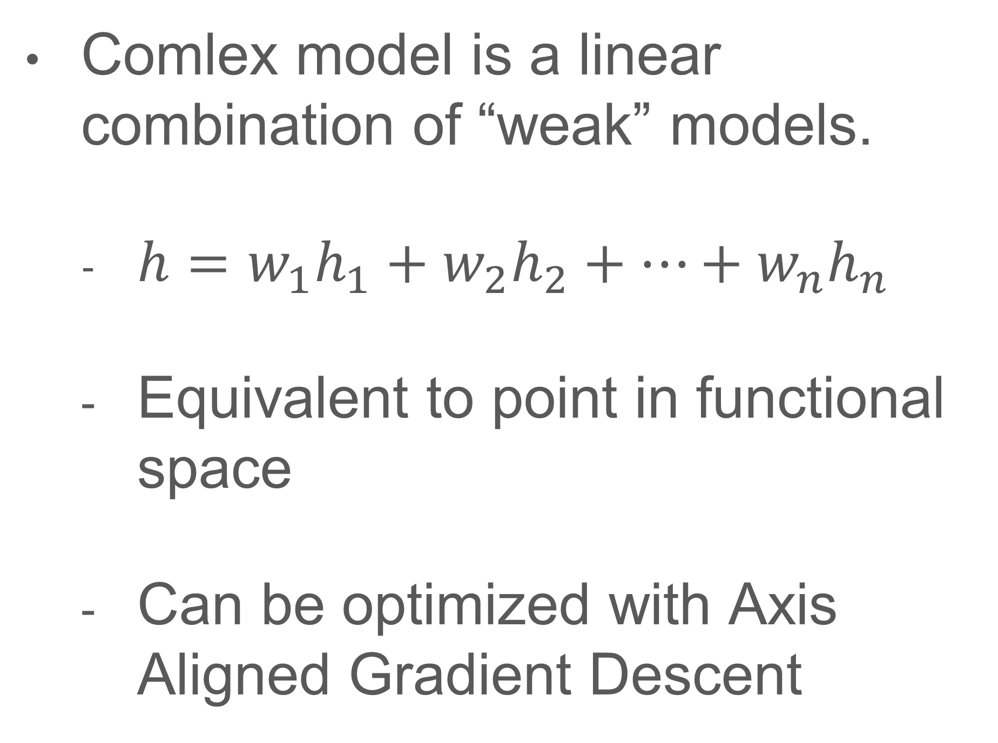
Gradient boosting process
Comlex model is a linear combination of “weak” models.
$h=w_{1}h_{1}+w_{2}h_{2}+…+w_{n}h_{n}$
Equivalent to point in functional space
Can be optimized with Axis Aligned Gradient Descent

Slide 10
Impementation

Slide 11
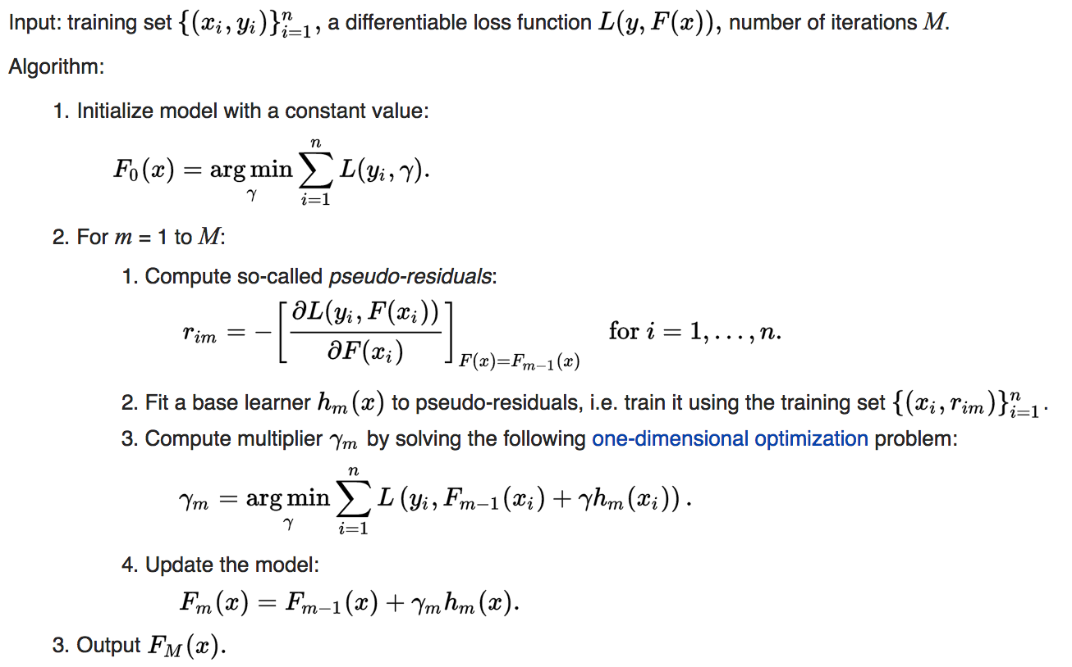
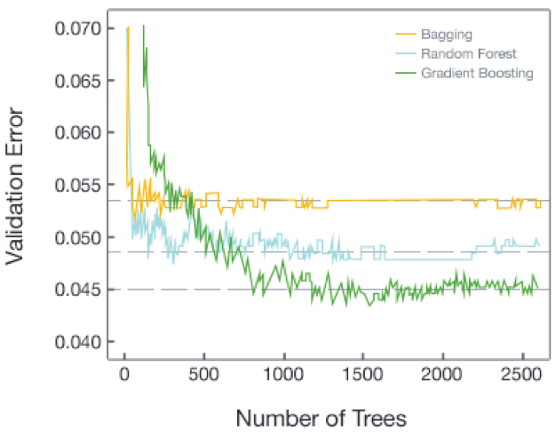
Gradient Boosting

Slide 12
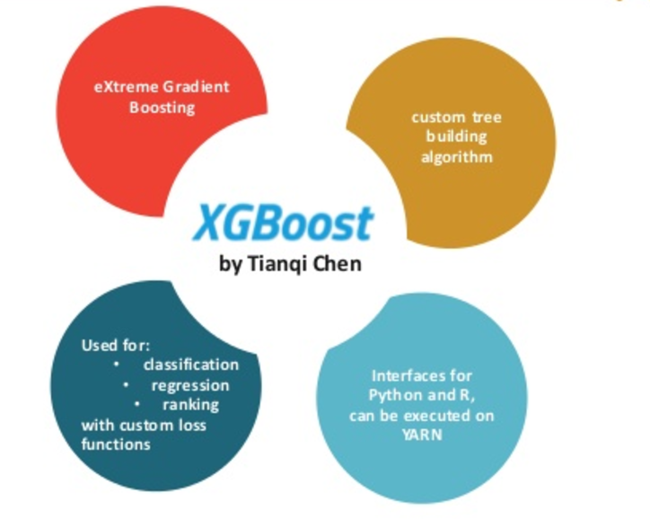
XGBoost
- Gradient Boosting Framework
- Combines the idea of Gradient Boosting and Decision Trees
- Suitable for both regression and classification problems
- Winner of many Kaggle competitions
- Fast speed, distributed and portable

